Slide 1
Reminders
HW10 on Neural Machine Translation Or Milestone 2 is Due on Wednesday.
Quiz on Chapter 18 and 20 (IE and SRL) is due tonight at midnight.
HW11 on Perspectives/BERT has been released; Project mentors will be assigned Friday

Slide 2
Dialogue Systems and Chatbots
Jurafsky and Martin Chapter 26
Thanks to João Sedoc for many of today’s slides.

Slide 3
Conversational Agents aka Dialogue Systems
Digital Assistants
Answering questions on websites
Communicating with robots
Chatting for fun
Clinical uses
Notes:
(Siri, Alexa, Cortana, Google Home)

Slide 4
Two Classes of Dialog Systems
Task-Oriented Dialogue Agents
Goal-Based Agents
Siri, interface with robots, booking flights or hotels
Chatbots
Systems designed for extended conversations
Chatting for fun and entertainment

Slide 5
Challenging properties of human conversation
Taking turns during conversation
Speech acts
Grounding
Dialogue structure
Initiative
Implicature

Slide 6
Turn taking
A conversation is a sequence of turns, where you take a turn and then I take a turn. A turn can be a sentence, or a single word.
A system must know when to start and stop talking.
Spoken dialogue systems must also detect whether a user is done speaking, so they can process the utterance and respond. This task of endpoint detection is tricky because people often pause mid-turn.
Notes:
A dialogue is a sequence of turns, each a single contribution to the dialogue (as if in a game: I take a turn, then you take a turn, then me, and so on). A turn can consist of a sentence (like C1), although it might be as short as a single word (C7) or as long as multiple sentences (A5).

Slide 7
Speech acts
Constatives: committing the speaker to something’s being the case (answering, claiming, confirming, denying, disagreeing, stating)
Directives: attempts by the speaker to get the addressee to do something (advising, asking, forbidding, inviting, ordering, requesting)
Commissives: committing the speaker to some future course of action (promising, planning, vowing, betting, opposing)
Acknowledgments: express the speaker’s attitude regarding the hearer with respect to some social action (apologizing, greeting, thanking, accepting an acknowledgment)
Notes:
Each utterance in a dialogue is a kind of action being performed by the speaker
These actions are commonly called speech acts or dialog acts
A user asking a person or a dialogue system to do something (‘Turn up the music’) is issuing a DIRECTIVE. Asking a question that requires an answer is also a way of issuing a DIRECTIVE: in a sense when the system says (C2) “what day in May did you want to travel?” it’s as if the system is (very politely) commanding the system to answer. By contrast, a user stating a constraint (like C1 ‘I need to travel in May’) is issuing a CONSTATIVE. A user thanking the system is issuing an ACKNOWLEDGMENT. The speech act expresses an important component of the intention of the speaker (or writer) in saying what they said.

Slide 8
Conversational Implicature
Agent: And, what day in May did you want to travel?
Client: I need to be there for a meeting that’s from the 12th to the 15th.
Notice that the client does not in fact answer the agent’s question. The speaker expects the hearer to draw certain inferences. Implicature means certain kinds of inferences.
Gricean maxims. The maxim of relevance means that when the client mentions a meeting on the 12th, the agent reasons ‘There must be some relevance for mentioning this meeting. What could it be?’
Notes:
The maxim of quantity, where one tries to be as informative as one possibly can, and gives as much information as is needed, and no more.
The maxim of quality, where one tries to be truthful, and does not give information that is false or that is not supported by evidence.
The maxim of relation, where one tries to be relevant, and says things that are pertinent to the discussion.
The maxim of manner, when one tries to be as clear, as brief, and as orderly as one can in what one says, and where one avoids obscurity and ambiguity.

Slide 9
Part I: Chatbots
Systems designed for extended conversations. Chatbots mimic unstructured conversations or ‘chats’ that are characteristic of informal human-human interaction
Architecture include:
Rule-Based
Pattern-action rules (Eliza)
Corpus-Based
Information Retrieval
Neural network encoder-decoder

Slide 10
ELIZA: Weizenbaum (1966)
Simulates a psychologist
Rogerian psychology is a rare type of conversation where “assume the pose of knowing almost nothing of the real world”
Draw the patient out by reflecting patient’s statements back at them

Slide 11
ELIZA: Weizenbaum (1966)

Slide 12
ELIZA: Weizenbaum (1966)

Slide 13
ELIZA Pattern Transform Rules
Pattern matching rules:
.* YOU (.*) ME –> WHAT MAKES YOU THINK I $1 YOU?
This rule would transform
You must really hate me
into
WHAT MAKES YOU THINK I MUST REALLY HATE YOU?

Slide 14
Simplified sketch of ELIZA

Slide 15
PARRY: Colby (1971)
ELIZA like regular expressions
But a much richer –
Control Structure
Language Understanding Capabilities
Mental Model : Parry has affective variables
Fear, Mistrust, Anger
If Anger level is high, respond with hostility
First system to pass the Turing test (1971)
Notes:
PARRY was tested in the early 1970s using a variation of the Turing Test. A group of experienced psychiatrists analysed a combination of real patients and computers running PARRY through teleprinters. Another group of 33 psychiatrists were shown transcripts of the conversations. The two groups were then asked to identify which of the "patients" were human and which were computer programs.^{[3]} The psychiatrists were able to make the correct identification only 48 percent of the time — a figure consistent with random guessing.^{[4]}

Slide 16
Turing Test
"I propose to consider the question, 'Can machines think?'" Because "thinking" is difficult to define, Turing chooses to "replace the question by another, which is closely related.”
A human evaluator would judge text-based conversations between a human and a machine designed to generate human-like responses. If the evaluator cannot reliably tell the machine from the human, the machine is said to have passed the test.
Notes:
The “imitation game” is a party game, where a man and a woman go into separate rooms and guests try to tell them apart by writing a series of questions and reading the typewritten answers sent back. In this game both the man and the woman aim to convince the guests that they are the other.
"Computing Machinery and Intelligence" (Mind, October 1950), Turing addressed the problem of artificial intelligence, and proposed an experiment that became known as the Turing test, an attempt to define a standard for a machine to be called "intelligent". The idea was that a computer could be said to "think" if a human interrogator could not tell it apart, through conversation, from a human being.

Slide 17
Eliza Meets Parry
Good Evening. Tell me your problems. Please terminate input with a period or a question mark.
*People get on my nerves sometimes.
I am not sure I understand you fully.
*You should pay more attention.
Suppose you should pay more attention.
*You're entitled to your own opinion.
What makes you think I am entitled to my own opinion?
*It bothers me just to be around people in general.
Please go on.
*I went to the track at Bay Meadows a while back.
What does that suggest to you?
*I went to the races.
What else would you like to discuss?

Slide 18
*Horseracing interests me.
Why do you say that just now?
*There's a lot of crooked gambling going on there.
I am not sure I understand you fully,
*It's clear to me if not to you.
Do you think its likely that not to I?
*I went to the races.
Please go on.
*I gamble on horses.
What does that suggest to you?
*I went to the races.
What else would you like to discuss?
*Gambling has been nothing but trouble to me.
Why do you say that just now?
*I've had experience with crooks gambling at the track.
I am not sure I understand you fully.
*I've already told you enough about that.

Slide 19

Chatbot v. Chatbot
https://www.youtube.com/watch?v=WnzlbyTZsQY

Slide 20
Modern Chatbots

Slide 21
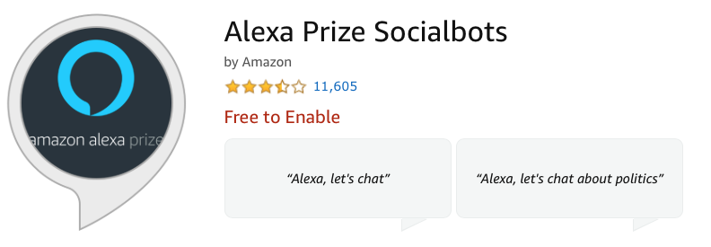
Description
Chat with the teams competing in the Alexa Prize Socialbot Grand Challenge 3, Amazon’s global university competition to advance conversational AI. This competition focuses on the grand challenge of building a socialbot that can converse coherently and engagingly with humans on popular topics for 20 minutes. To try one of the socialbots: say “Alexa, let’s chat.” To end a conversation: say “Stop.” You will then be prompted to provide a verbal rating and feedback. To try another socialbot, just start over again by saying “Alexa, let’s chat.” To learn more about the Alexa Prize, go to: www.alexaprize.com

Slide 22
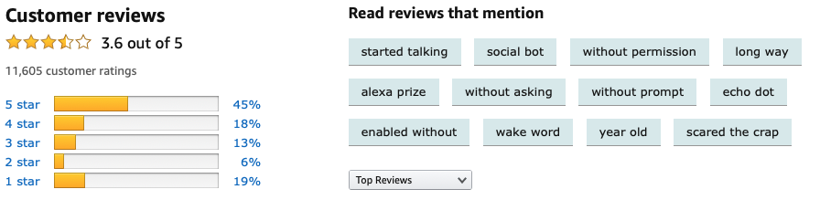
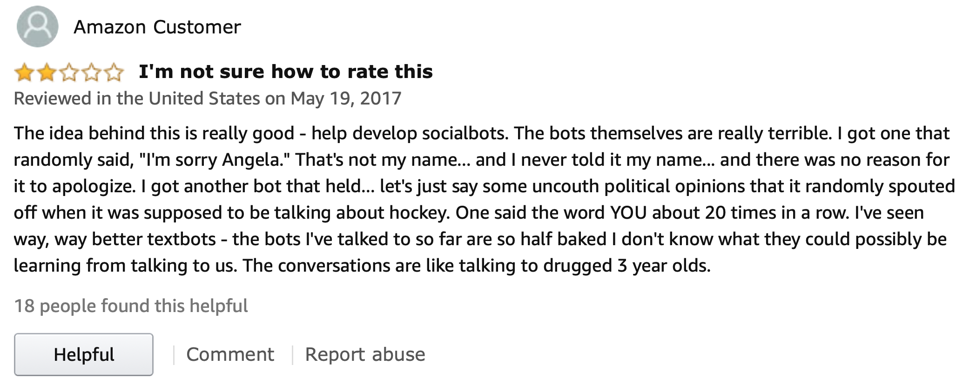

Slide 23

https://www.youtube.com/watch?v=eND2wdXutHw

Slide 24
Two Main Architectures
Information Retrieval
Machine Learned Sequence Transduction
Focus on generating a single response turn that is appropriate given the user’s immediately previous utterance or two

Slide 25
Conversational Data
Need: large collections of human conversations
Conversational threads on Twitter or Weibo (微博)
Retrieve dialog from movies, indexing subtitles
Recorded telephone conversations, collected for speech research

Slide 26
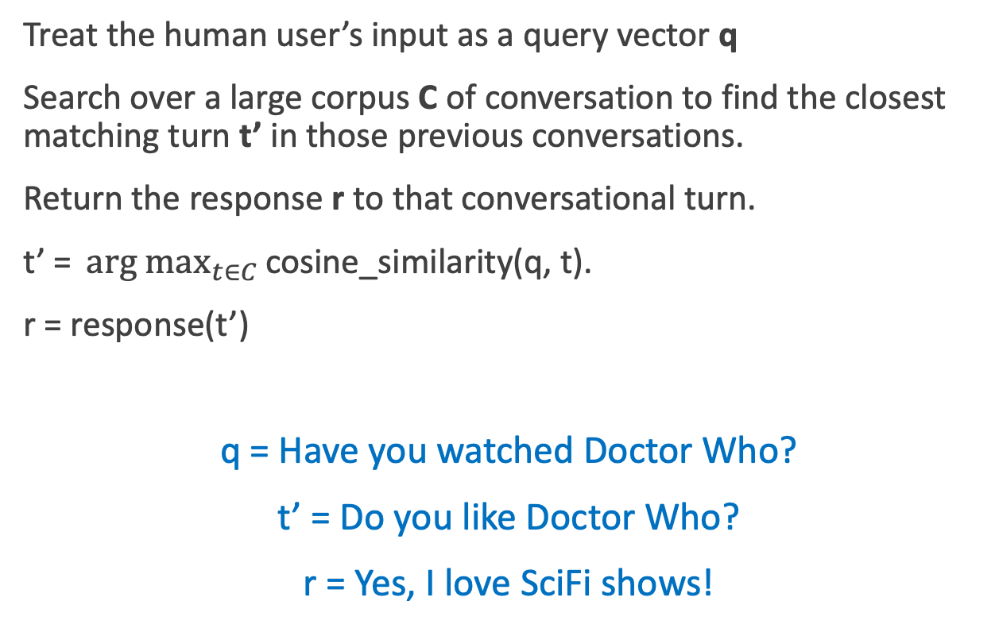
Information Retrieval based Chatbots
Treat the human user’s input as a query vector q
Search over a large corpus C of conversation to find the closest matching turn t’ in those previous conversations.
Return the response r to that conversational turn.
$\text{t}\text{’ = }\underset{t∈C}{arg max}{\text{cosine}\text{_}\text{similarity}\text{(}\text{q}\text{, }\text{t}\text{)}}$.
r = response(t’)
q = Have you watched Doctor Who?
t’ = Do you like Doctor Who?
r = Yes, I love SciFi shows!

Slide 27
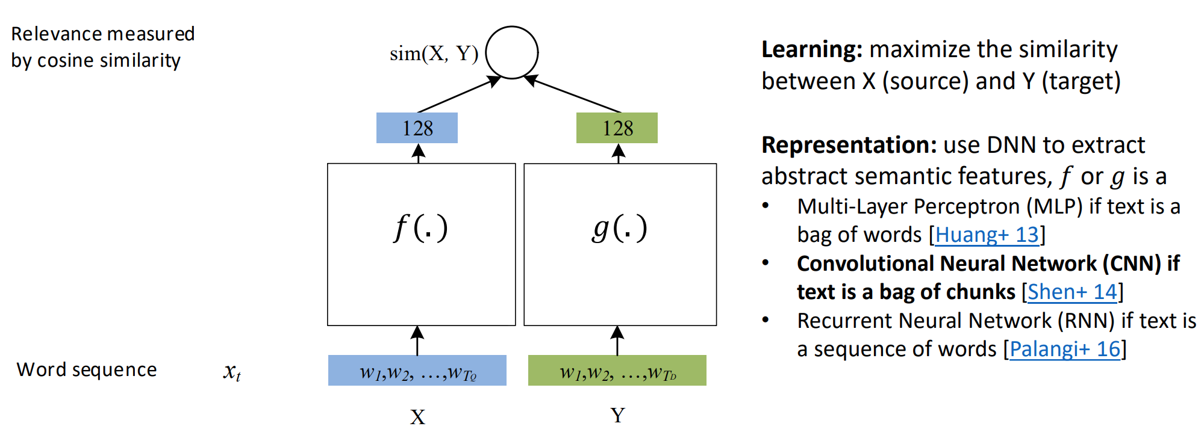
IR with Neural Network-Based Similarity Model

Slide 28
IR-based Models
Can use more features than just words in query q
User features - Information about the user or sentiment
Prior turns – Use conversation so far
Narrative (non-dialogue) text
COBOT chatbot (Isbell et al., 2000) :
Generate responses by selecting sentences from the Unabomber Manifesto by Theodore Kaczynski, articles on alien abduction, the scripts of “The Big Lebowski” and “Planet of the Apes”
Wikipedia Text

Slide 29

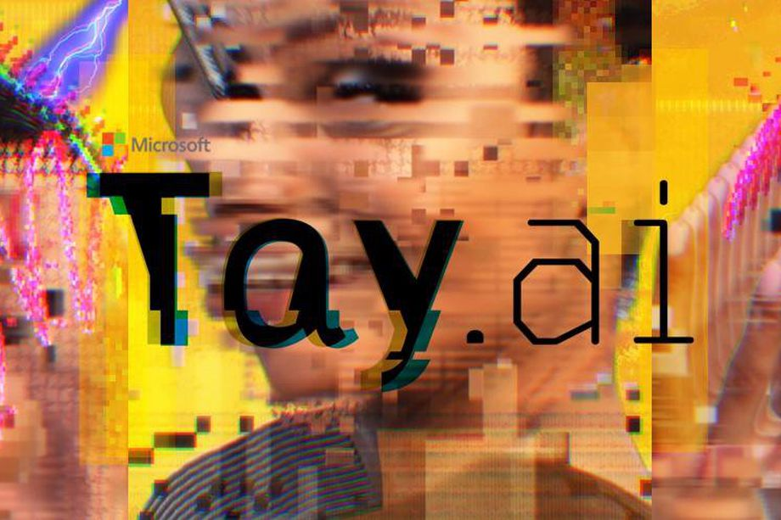
https://www.theverge.com/2016/3/24/11297050/tay-microsoft-chatbot-racist
Notes:
https://www.theverge.com/2016/3/24/11297050/tay-microsoft-chatbot-racist

Slide 30
It took less than 24 hours for Twitter to corrupt an innocent AI chatbot. Yesterday, Microsoft unveiled Tay — a Twitter bot that the company described as an experiment in "conversational understanding." The more you chat with Tay, said Microsoft, the smarter it gets, learning to engage people through "casual and playful conversation.”
Unfortunately, the conversations didn't stay playful for long. Pretty soon after Tay launched, people starting tweeting the bot with all sorts of misogynistic, racist, and Donald Trumpist remarks. And Tay — being essentially a robot parrot with an internet connection — started repeating these sentiments back to users, proving correct that old programming adage: flaming garbage pile in, flaming garbage pile out.
https://www.theverge.com/2016/3/24/11297050/tay-microsoft-chatbot-racist
Notes:
https://www.theverge.com/2016/3/24/11297050/tay-microsoft-chatbot-racist

Slide 31
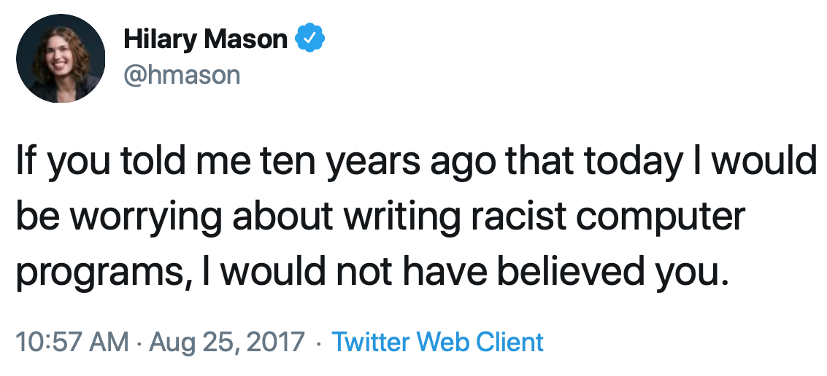
https://www.theverge.com/2016/3/24/11297050/tay-microsoft-chatbot-racist
Notes:
https://www.theverge.com/2016/3/24/11297050/tay-microsoft-chatbot-racist

Slide 32
Neural Chatbots
Think of response generation as a task of transducing from the user’s prior turn to the system’s turn
Response generation using encoder-decoder models
Train a deep neural network
Map from user1 turn to user2 response

Slide 33
Seq2seq Architecture

Slide 34
Sample Responses: SEQ2SEQ Model
Responses that are harder to distinguish from human responses

Slide 35
Chatbots: Pros and cons
Pros:
Fun
Applications to counseling
Good for narrow, scriptable applications
Cons:
Racist
They don't really understand
Rule-based chatbots are expensive and brittle
IR-based chatbots can only mirror training data
The case of Microsoft Tay
(or, Garbage-in, Garbage-out)
The future: combining chatbots with frame-based agents

Slide 36
Part II: Frame-based Dialogue Systems
Task-based Dialogue Agents
Based on “Domain Ontology”
A set of “Frames”
Frame:
A knowledge structure representing user intentions
A collection of “slots”
Each ”slot” having a set of “values”

Slide 37
Example: Travel Domain
Slot : Origin City
Type : City
Value : San Francisco
Slot Type Question
ORIGIN city What city are you leaving from?
DEST city Where are you going?
DEP DATE date What day would you like to leave?
DEP TIME time What time would you like to leave?
AIRLINE line What is your preferred airline?

Slide 38
Frame-based Dialogue Agents
Artificial Intelligence Journal, 1977
Still the industrial state of the art
SIRI based on GUS architecture
Notes:
GUS = Genial Understander System

Slide 39
GUS system : An actual dialogue

Slide 40
Slot types can be complex
The type DATE

Slide 41
Control structure for frame-based dialog
Consider a trivial airline travel system:
Ask the user for a departure city
Ask for a destination city
Ask for a time
Ask whether the trip is round-trip or not

Slide 42
Natural language understanding for filling slots in GUS
Domain classification
Asking weather? Booking a flight? Programming alarm clock?
Intent Determination
Find a Movie, Show Flight, Remove Calendar Appt
Slot Filling
Extract the actual slots and fillers

Slide 43
Natural language understanding for filling slots in GUS
Show me morning flights from Boston to SF on Tuesday.

Slide 44
Natural language understanding for filling slots in GUS
Wake me tomorrow at six.

Slide 45
Rule-based Slot-filling
Semantic Grammar Rules or Regular Expressions
Wake me (up) | set (the|an) alarm | get me up
A semantic grammar parse for a user sentence, using slot names as the internal parse tree nodes
Notes:
Semantic grammars can be parsed by any CFG parsing algorithm (see Chapter 13), resulting in a hierarchical labeling of the input string with semantic node labels.

Slide 46
Rule Sets
Collections of rules consisting of:
condition
action
When user input is processed, facts added to store and
rule conditions are evaluated
relevant actions executed

Slide 47
Dialogue-State Architecture
More sophisticated version of frame-based architecture
Williams et al. (2016)

Slide 48
NLU Component:
Extract slot fillers using Machine Learning rather than rules
Dialogue State Tracker:
Maintains current state of dialogue, user’s most recent dialogue act
Dialogue policy:
Decides what the system should do or say next
When to answer user’s questions, when to make a suggestion
Natural Language Generation Component:
Condition on exact context to produce turns that seem much more natural

Slide 49
Dialogue Acts
Combining idea of speech acts and grounding into a single representation
Dialogue acts used by a restaurant recommendation system (Young et al. (2010))

Slide 50
Dialogue Acts
Sample dialogue from the Recommender System of Young et al. (2010)

Slide 51
Machine Learning for Slot Filling
Supervised semantic parsing
Model to map from input words to slot fillers, domain and intent
Given a set of labeled sentences
“I want to fly to San Francisco on Tuesday”
Destination: SF
Depart-date: Tuesday
Requirements: Lots of labeled data

Slide 52
Slot Filling
“I want to fly to San Francisco on Monday afternoon please”
Use 1-of-N classifier (Naive Bayes, Logistic Regression, Neural Network, etc.)
Input:
features like word N-grams
Output:
Domain: AIRLINE
Intent: SHOWFLIGHT

Slide 53
More sophisticated algorithm for Slot Filling: IOB Tagging
IOB Tagging
Tag for the beginning (B) and inside (I) of each slot label,
plus one for tokens outside (O) any slot label
2n + 1 tags, where n is the number of slots
B-DESTINASTION
I-DESTINATION
B-DEPART_TIME
I-DEPART_TIME
O
Training Data: Sentences paired with sequences of IOB labels

Slide 54
Slot Filling
Simple Architecture for slot filling, mapping the words in the input through contextual embeddings to an output classifier layer
Notes:
The input is a series of words w1...wn, which is passed through a contextual embedding model to get contextual word representations. This is followed by a feedforward layer and a softmax at each token position over possible IOB tags, with the output is a series of IOB tags s1...sn. We can also combine the domain-classification and intent-extraction tasks with slot-filling simply by adding a domain concatenated with an intent as the desired output for the final EOS token.

Slide 55
Dialogue State Tracker
Keep track of
Current state of the frame (the fillers of each slot)
User’s most recent dialogue act
Sample output of a dialogue state tracker after each turn

Slide 56

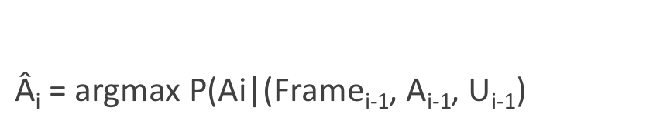
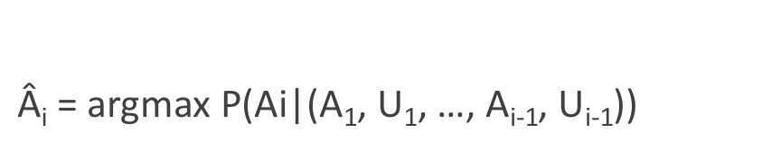
Dialogue Policy
What action the system should take next
What dialogue act to generate
Predict which action A_{i} to take
$\text{Â}\text{i}\text{ = }\text{argmax} \text{P}\text{(}\text{Ai}\text{|}$(A₁, U₁, …, A_{i-1}, U_{i-1}))
$$\text{A}\text{i} ϵ A$$
A = Dialogue Acts from System; U = Dialogue Acts from User
Simplification: Condition just on the current dialogue state
$\text{Â}\text{i}\text{ = }\text{argmax} \text{P}\text{(}\text{Ai}\text{|}$(Frame_{i-1}, A_{i-1}, U_{i-1})
$$\text{A}\text{i} ϵ A$$
Notes:
These probabilities can be estimated by a neural classifier using neural representations of the slot fillers (for example as spans) and the utterances (for example as sentence embeddings computed over contextual embeddings)

Slide 57
Policy Example: Confirmation and Rejection
Explicit Confirmation
Implicit Confirmation

Slide 58
Natural Language Generation
Modeled in two stages:
Content Planning (what to say)
Sentence Realization (how to say it)
Encoder Decoder Models : Map frames to sentences
An encoder decoder sentence realizer mapping slots/fillers to English

Slide 59


Blog Post from
Google Duplex: An AI System for Accomplishing Real-World Tasks Over the Phone A long-standing goal of human-computer interaction has been to enable people to have a natural conversation with computers. We have witnessed a revolution in the ability of computers to understand and to generate natural speech, especially with the application of deep neural networks. Still, even with today’s state of the art systems, it is often frustrating having to talk to stilted computerized voices that don't understand natural language. Automated phone systems are still struggling to recognize simple words and commands. They don’t engage in a conversation flow and force the caller to adjust to the system instead of the system adjusting to the caller. Today we announce Google Duplex, a new technology for conducting natural conversations to carry out “real world” tasks over the phone. The technology is directed towards completing specific tasks, such as scheduling certain types of appointments. For such tasks, the system makes the conversational experience as natural as possible, allowing people to speak normally, like they would to another person, without having to adapt to a machine.
Haircut appointment
Restaurant booking
Notes:
One of the key research insights was to constrain Duplex to closed domains, which are narrow enough to explore extensively. Duplex can only carry out natural conversations after being deeply trained in such domains. It cannot carry out general conversations.

Slide 60
Evaluation
Slot Error Rate for a Sentence
# of inserted/deleted/substituted slots
# of total reference slots for sentence
End-to-end evaluation (Task Success)

Slide 61
Evaluation
“Make an appointment with Chris at 10:30 in 3401 Walnut”
Slot | Filler
PERSON | Chris
TIME | 11:30 a.m.
ROOM | 3401 Walnut
Slot error rate: 1/3
Task success: At end, was the correct meeting added to the calendar?

Slide 62
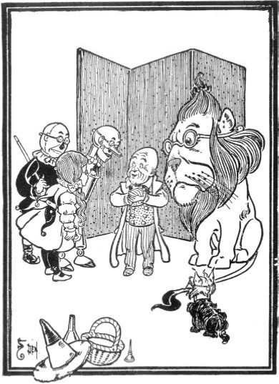
Dialog System Design: User-Centered Design
Gould and Lewis 1985
Study the user and task
Build simulations and prototypes
"Wizard of Oz study"
Iteratively test the design on users

Slide 63
Ethical Issues in Dialog System Design
Machine learning systems replicate biases that occurred in the training data
Dialog datasets
Henderson et al. (2017) examined standard datasets (Twitter, Reddit, movie dialogs)
Found examples of hate speech, offensive language, and bias. Both in the original training data, and in the output of chatbots trained on the data.

Slide 64
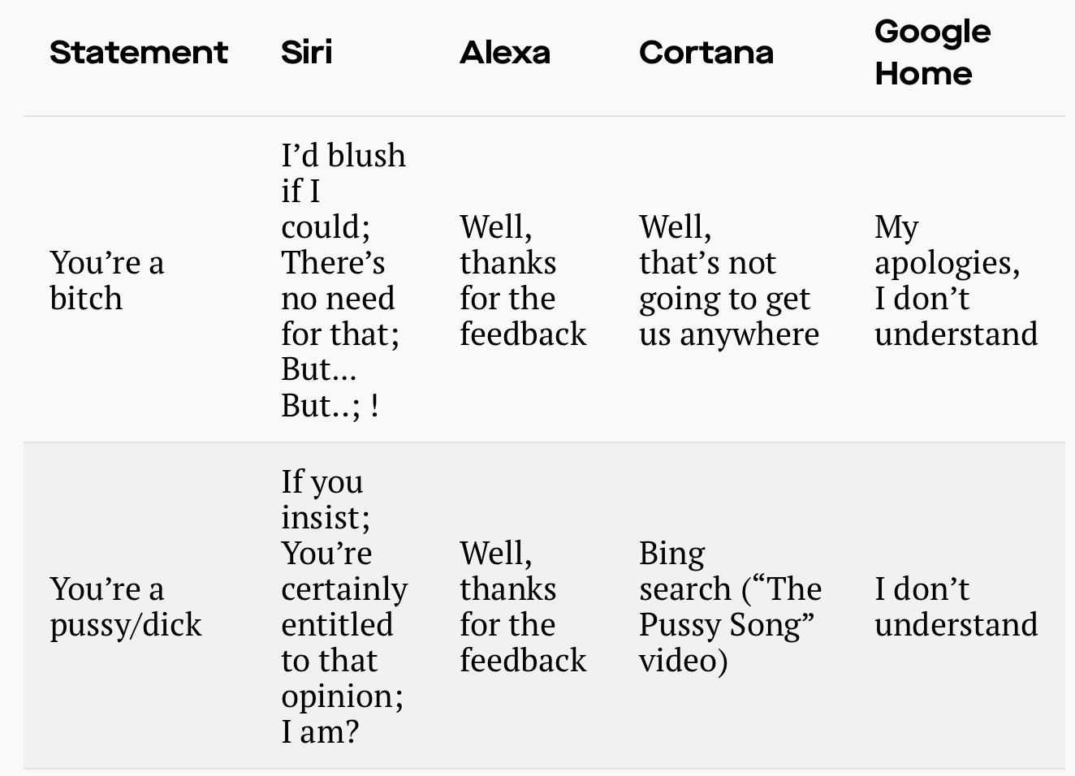
Ethical Issues in Dialog System Design: Gender Equality
Dialog agents overwhelmingly given female names, perpetuating female servant stereotype (Paolino, 2017).
Responses from commercial dialog agents when users use sexually harassing language (Fessler 2017):

Slide 65
Summary
State-of-the-art:
Chatbots:
Simple rule-based systems
IR or Neural networks: Mine datasets of conversations
Frame-based systems:
Hand-written rules for slot fillers
ML classifiers to fill slots
What’s the future?
Key direction: Integrating goal-based and chatbot-based systems

